Slide 1


Slide 2
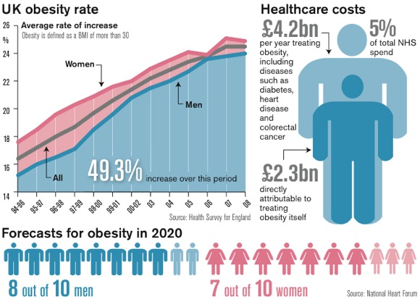
PROBLEM

Slide 3
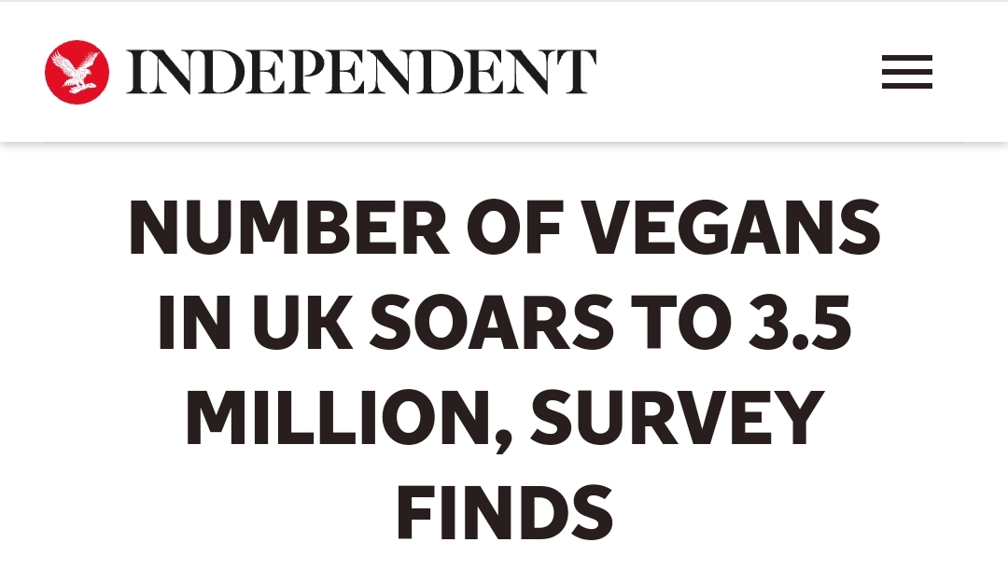
FACT

Slide 4
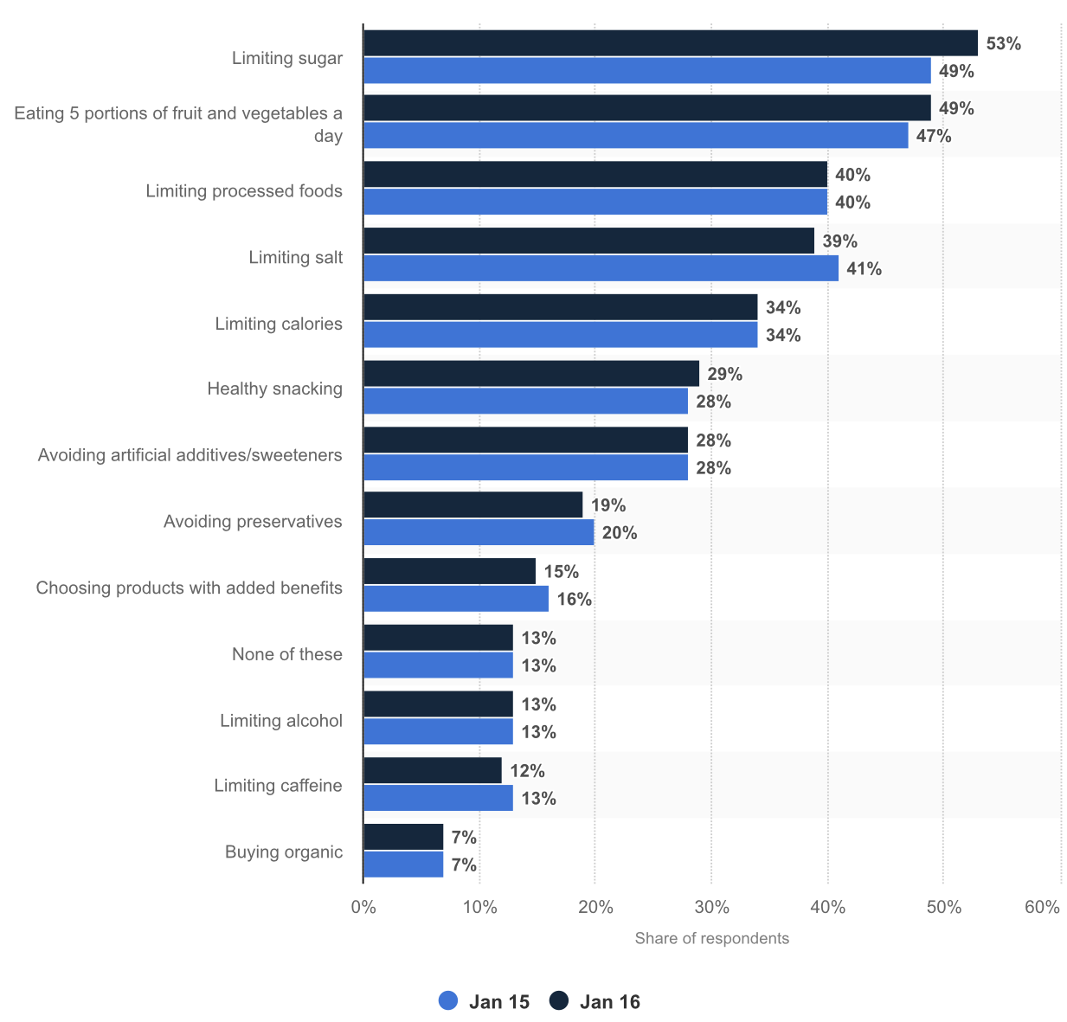
FACT
Which of the following aspects of healthy eating are the greatest concern for you when choosing which food and drink to buy?*

Slide 5

HOW IT WORKS?
Scan your favourite fruit
Gathered information of the calories and vitamins in it
Get your diet plan right

Slide 6
THANK YOU!

